Slide 1

Regression Project
The aim is to analyse and predict average temperature from the agri-food sector
The Aim
Analyse and predict average temperature using agricultural emissions and activity data (FAO + IPCC).
Understand climate impacts and develop sustainable strategies for policymakers and agri-businesses.
The Dataset
~7,000 records
30+ agri-food activity & emission features (fires, residues, manure, fertilizer, packaging, populations, etc.).
Coverage: 236 countries, 1990–2020.

Slide 2
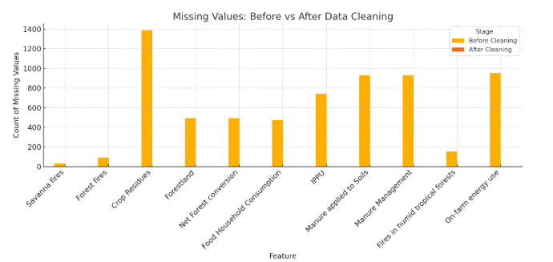
Data Cleaning
The Challenge
Dataset contained ~7000 records, 30+ features
Missing values across 11 key variables (up to ~20% in some columns)
Risk of duplicated rows and inconsistent entries
Our Approach
Removed exact duplicates (kept unique Area-Year pairs)
Imputed missing values:
Per-country median to preserve national trends
Global median fallback for all-NaN groups
Dropped no rows → preserved dataset size
Verified with summary checks: 0 missing values, 6965 rows, 31 columns
Outcome
A complete, consistent dataset ready for exploratory analysis and regression
Ensured no data loss while maintaining statistical integrity

Slide 3
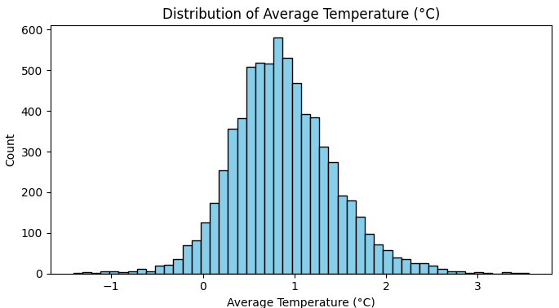
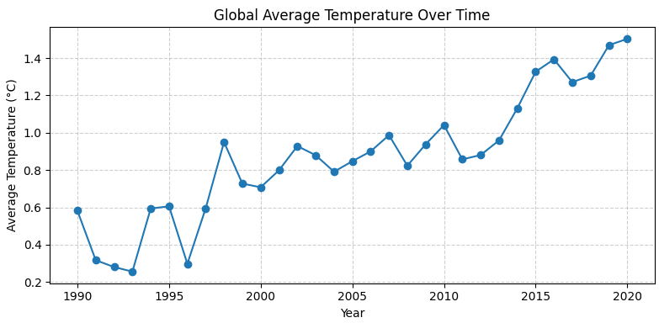
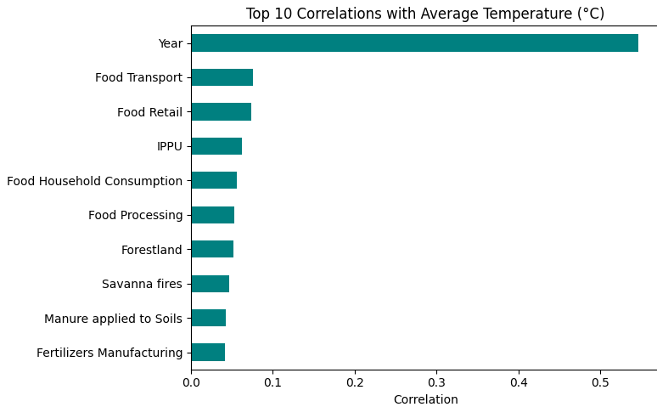
Exploratory Analysis (EDA)
Temperature distribution shows a normal distribution, albeit slightly right-skewed
Clear upward trend in global average temperature over 30 years.
Key agricultural and population drivers show strong correlations with temperature. Agriculture contribute 6 of top 10 correlations.
Predictors are highly interrelated (multicollinearity risk).

Slide 4
Multicollinearity Challenge
The Issue
Many predictors (e.g., population, food system activities) are highly correlated.
This causes unstable regression coefficients, inflated errors, and reduced interpretability.
Example: Food Packaging, IPPU, and Household Consumption all have VIF > 50.
Evidence (VIF Analysis)
Very high VIFs indicate redundancy:
Food Packaging: 69.4
IPPU: 67.0
Household Food Consumption: 52.2
Moderate but concerning VIFs: Manure applied to Soils (31.3), Urban Population (24.6).
Safe predictors (VIF < 5): Forestland, Savanna fires, Year.
Implications
Cannot include all predictors in a standard regression model.
Requires:
Variable reduction (select representative features), or
Regularization techniques (Ridge/Lasso regression), or
Dimensionality reduction (PCA).

Slide 5
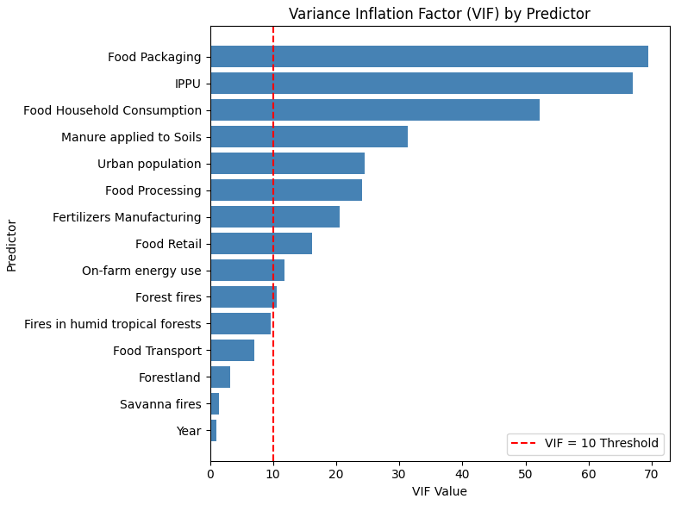
Multicollinearity Challenge continued
Several predictors show very high VIF values (e.g., Food Packaging, IPPU > 60)
Strong redundancy among food-system activities and population measures
Some predictors remain safe (e.g., Forestland, Savanna fires, Year)
Implication: Need feature reduction or regularization (Ridge/Lasso)

Slide 6
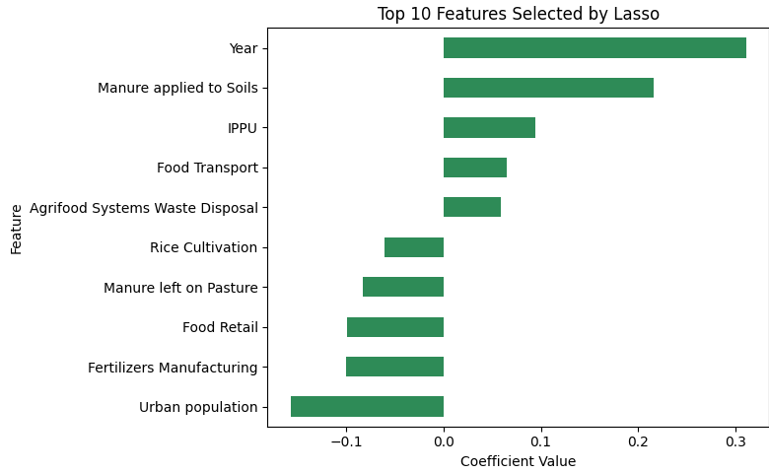
Feature Engineering
Defined predictors (30+ numeric features) and target (Average Temperature °C).
Standardized all features for fair comparison in regression models.
Lasso reduced redundancy by shrinking irrelevant features to zero.
Highlighted the most important drivers of temperature, e.g.:
Year (+)
Manure applied to Soils (+)
Urban population (–)

Slide 7
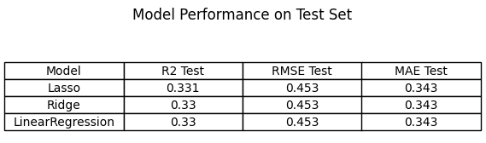
Regression Models
Linear Regression – simple, interpretable baseline to capture relationships between predictors and temperature.
Ridge Regression (L2) – reduces the impact of multicollinearity, stabilizing coefficient estimates.
Lasso Regression (L1) – performs feature selection by shrinking unimportant coefficients to zero, highlighting key drivers.
All three models achieved similar predictive performance with R² around 0.33 and RMSE ≈ 0.45 °C. While Linear Regression provides a simple baseline, it is sensitive to multicollinearity. Ridge Regression stabilizes coefficients under highly correlated predictors, and Lasso Regression not only manages collinearity but also performs feature selection, highlighting the most influential agricultural drivers of temperature. Together, the regularized models (Ridge and Lasso) provide more robust and interpretable insights.

